Slide 1
D.C. Everest Elementary ELL Program
January 2013

Slide 2
ELL Demographics by School
Evergreen Elementary School
32 Students
Hatley Elementary School
Mountain Bay Elementary School
59 Students
4 Students
Riverside Elementary School
22 Students
Rothschild Elementary School
40 Students
Weston Elementary School
152 Students
Total
309 Students

Slide 3
Languages Spoken in the District at the Elementary Level
Spanish
Laotian
Chinese
Cambodian
Hmong
Ukrainian
Vietnamese
Nepali
Pashto/Urdu
Arabic
Russian

Slide 4
Initial Identification of ELL Students
Home Language Survey
English Proficiency Screener
Language Development Plan (LDP)
Identify home language(s) other than English
WAPT or WIDA Model
Records of previous language assessments
Test accommodations, service plan, individualized language objectives, classroom accommodations, and permission for services

Slide 5
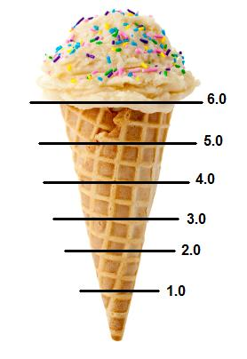
English Proficiency
6- Reaching
5- Bridging
4- Expanding
3- Developing
2- Beginning
1- Entering
Levels
Ice Cream Model

Slide 6
Types of ELL Services Available
Pull-Out Support
Push-In Support (Inclusionary Support)
1:1 Support
Bilingual Support

Slide 7
ACCESS Testing
What is it?
It is a standards-based criterion referenced English language proficiency test designed to measure English language learners’ social and academic proficiency in English.
Who takes it?
Every identified English Language Learner including those who have refused services.
When does it take place?
Beginning December – Mid February
How is it administered?
Kindergarten: One 45 minute session with outside proctor
Grades 1-5:
One-20 minute individual speaking session with outside proctor
Two- 75 minute group sessions for listening, reading, and writing with ELL teacher

Slide 8
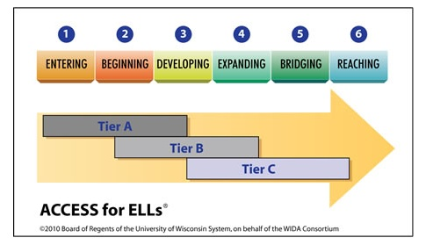

Slide 9
Exit Criteria
OR
Automatic Reclassification
Manual Reclassification

Slide 10
Resources
ELL Staff
“A Teacher’s Survival Guide : Getting Started Working with English Language Learners”
Student Language Development Plan (LDP)
WIDA (World-Class Instructional Design and Assessment)
Can-Do Descriptors

Slide 11
Closing
The elementary ELL staff would like to thank you for your continued support with the ELL students in our district.

Slide 12
Automatic Reclassification
ELP 6 in grades K-12 by achieving a composite (overall) score of 6.0 on ACCESS for ELLs, Wisconsin’s English-language proficiency assessment;
OR
ELP 6 in grades 4- 12 by achieving a composite (overall) score of 5.0 or above plus a minimum literacy subscore of 5.0 or above on the ACCESS for ELLs.
Back

Slide 13
Manual Reclassification
Limited English Proficient (ELP 5) to Fully English Proficient (ELP 6).
Students may be manually reclassified by districts to Fully English Proficient status (ELP 6) when the student achieves a composite (overall) score of 5.0 or above on the ACCESS for ELLs and the student shows clear evidence of English proficiency, but was not automatically reclassified because the student did not meet the Literacy subscore benchmark.
Fully English Proficient (ELP 6) to Limited English Proficient (ELP 5) .
Students who were automatically reclassified to Fully English Proficient status (ELP 6) may be manually reclassified to ELP 5 and maintain their English Language Learner (ELL)/Limited English Proficiency (LEP) status. If observations and academic performance indicate that a student should maintain their LEP status, the language level code in ISES (Individual Student Enrollment System) may be manually changed to an ELP 5, continuing the student’s LEP status.
Back

